Slide 1
Secure data handling In images using Steganography
CAPSTONE PROJECT
Presented by,
Student Name : Mohan Raju Kadambande
Department : Computer Engineering
College Name : Dr. D Y Patil College of Engineering &
Innovation, Varale, Talegaon, Pune

Slide 2
OUTLINE
Problem Statement
Technology used
Wow factor
End users
Result
Conclusion
Git-hub Link
Future scope

Slide 3
Problem Statement
The challenge of secure data handling in images using steganography involves embedding sensitive information within digital images while ensuring confidentiality, integrity, and imperceptibility. Key concerns include maintaining image quality, resistance to attacks like steganalysis, and optimizing storage and computational efficiency.
Developing robust algorithms that balance security, capacity, and undetectability is crucial for practical applications in secure communication and data protection.

Slide 4
Technology used
OpenCV, short for built-in Computer Vision Library, is an open-source computer vision and machine learning software library.
Originally developed by Intel, it is now maintained by a community of developers under the OpenCV Foundation.
We have used cv2 library from OpenCV and a built-in python library os.
Cv2 : The cv2 module is the main module in OpenCV that provides developers with an easy-to-use interface for working with image and video processing functions.
Os : The os library provides a wealth of functions that allow us to interact with the underlying operating system, including accessing and manipulating the file system, environment variables, and even processes.

Slide 5
Wow factors
An image steganography project with separate source code files for encryption and decryption stands out due to its modular design, allowing independent development and optimization of both processes.
It enhances security by keeping the embedding and extraction mechanisms distinct, reducing vulnerabilities.
This structure improves maintainability and debugging while enabling scalability for integration into larger secure communication systems.
Additionally, it allows flexibility in implementing different encryption techniques, ensuring a more robust and adaptable steganography solution.

Slide 6
End users
The end users of an image steganography project include cybersecurity professionals who need secure communication methods and individuals seeking privacy in data exchange.
Government agencies and intelligence organizations use it for covert messaging and classified information protection.
Journalists and activists rely on steganography to communicate safely in regions with censorship.
Additionally, developers and researchers use it to explore advancements in data hiding and encryption techniques.

Slide 7
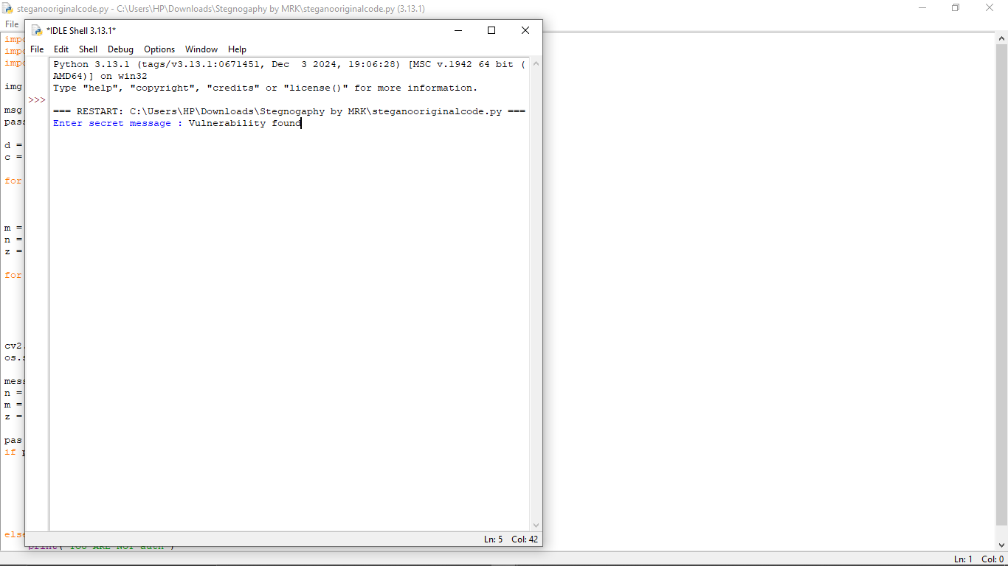
Results
User enters the secret message.

Slide 8
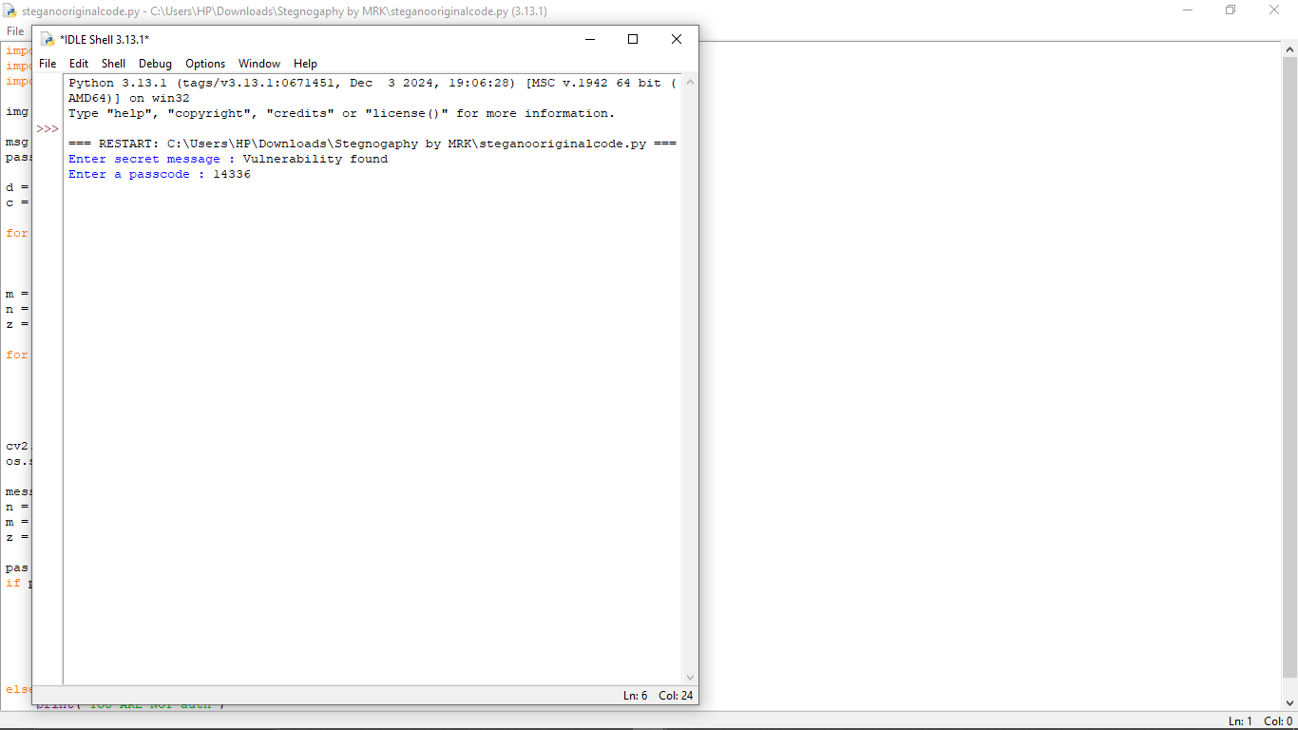
Results
User enters the secret passcode to encrypt the message.(Encryption Key)

Slide 9
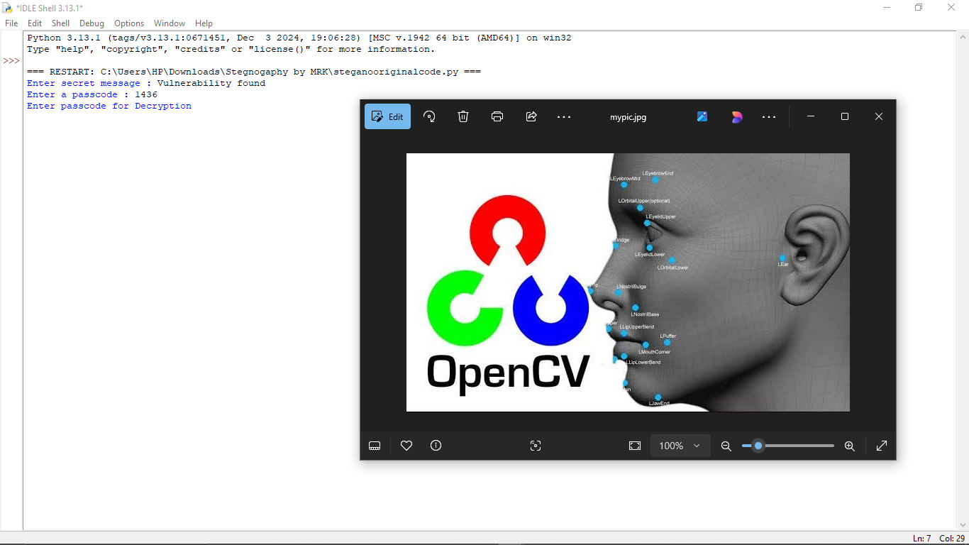
Results
After entering secret passcode to encrypted image is generated.

Slide 10
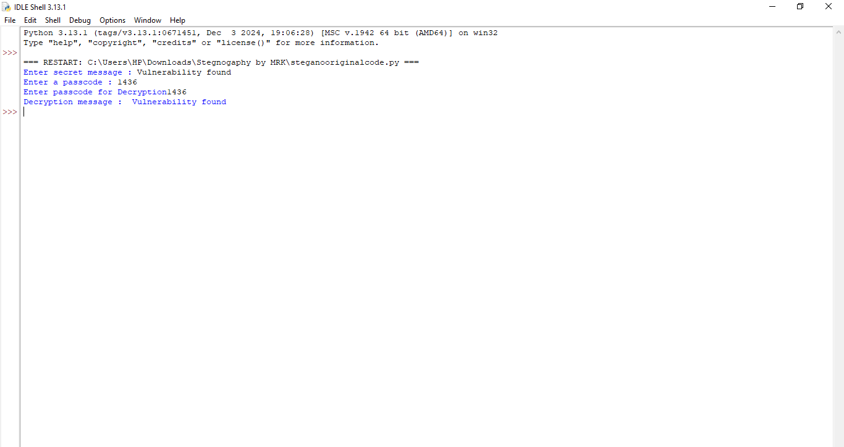
Results
User re-enters the secret passcode to decrypt the message.(Decryption Key)

Slide 11
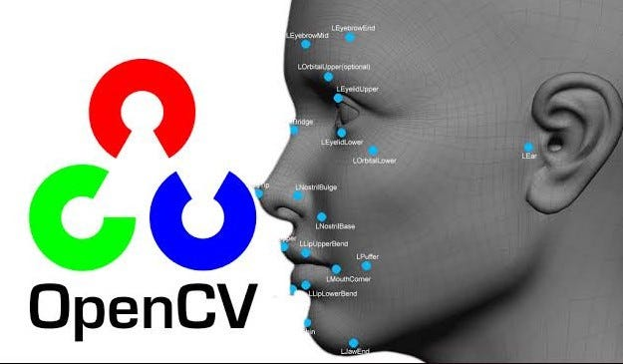
Results
Image before Encryption

Slide 12

Results
Image after Encryption

Slide 13
Conclusion
A well-designed steganographic approach should effectively embed sensitive data while preserving image quality and resisting detection through steganalysis.
Ensuring a balance between security, capacity, and computational efficiency is essential for real-world applications.
Continued research and innovation in steganographic algorithms will enhance secure communication and data protection.
Ultimately, achieving robust, undetectable, and efficient data hiding methods remains a key objective in the field.

Slide 14
GitHub Link
The Git hub link for the project is :
https://github.com/mohan-11/Stegnography.git
Click here for project code

Slide 15
Future scope
The future scope of an image steganography project with separate encryption and decryption files includes enhancing security with AI-driven encryption techniques and deep learning-based steganalysis resistance.
It can be integrated with blockchain for secure and tamper-proof data exchange.
Future advancements may also focus on real-time steganography for secure messaging applications.
Additionally, improvements in compression and encoding techniques can make hidden data more resilient against detection and modification.

Slide 16
THANK YOU

